Slide 1

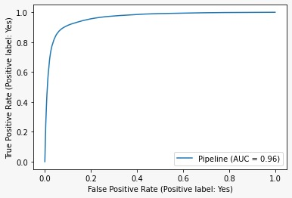
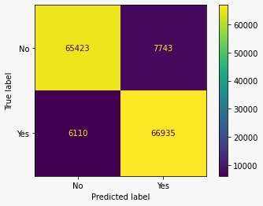
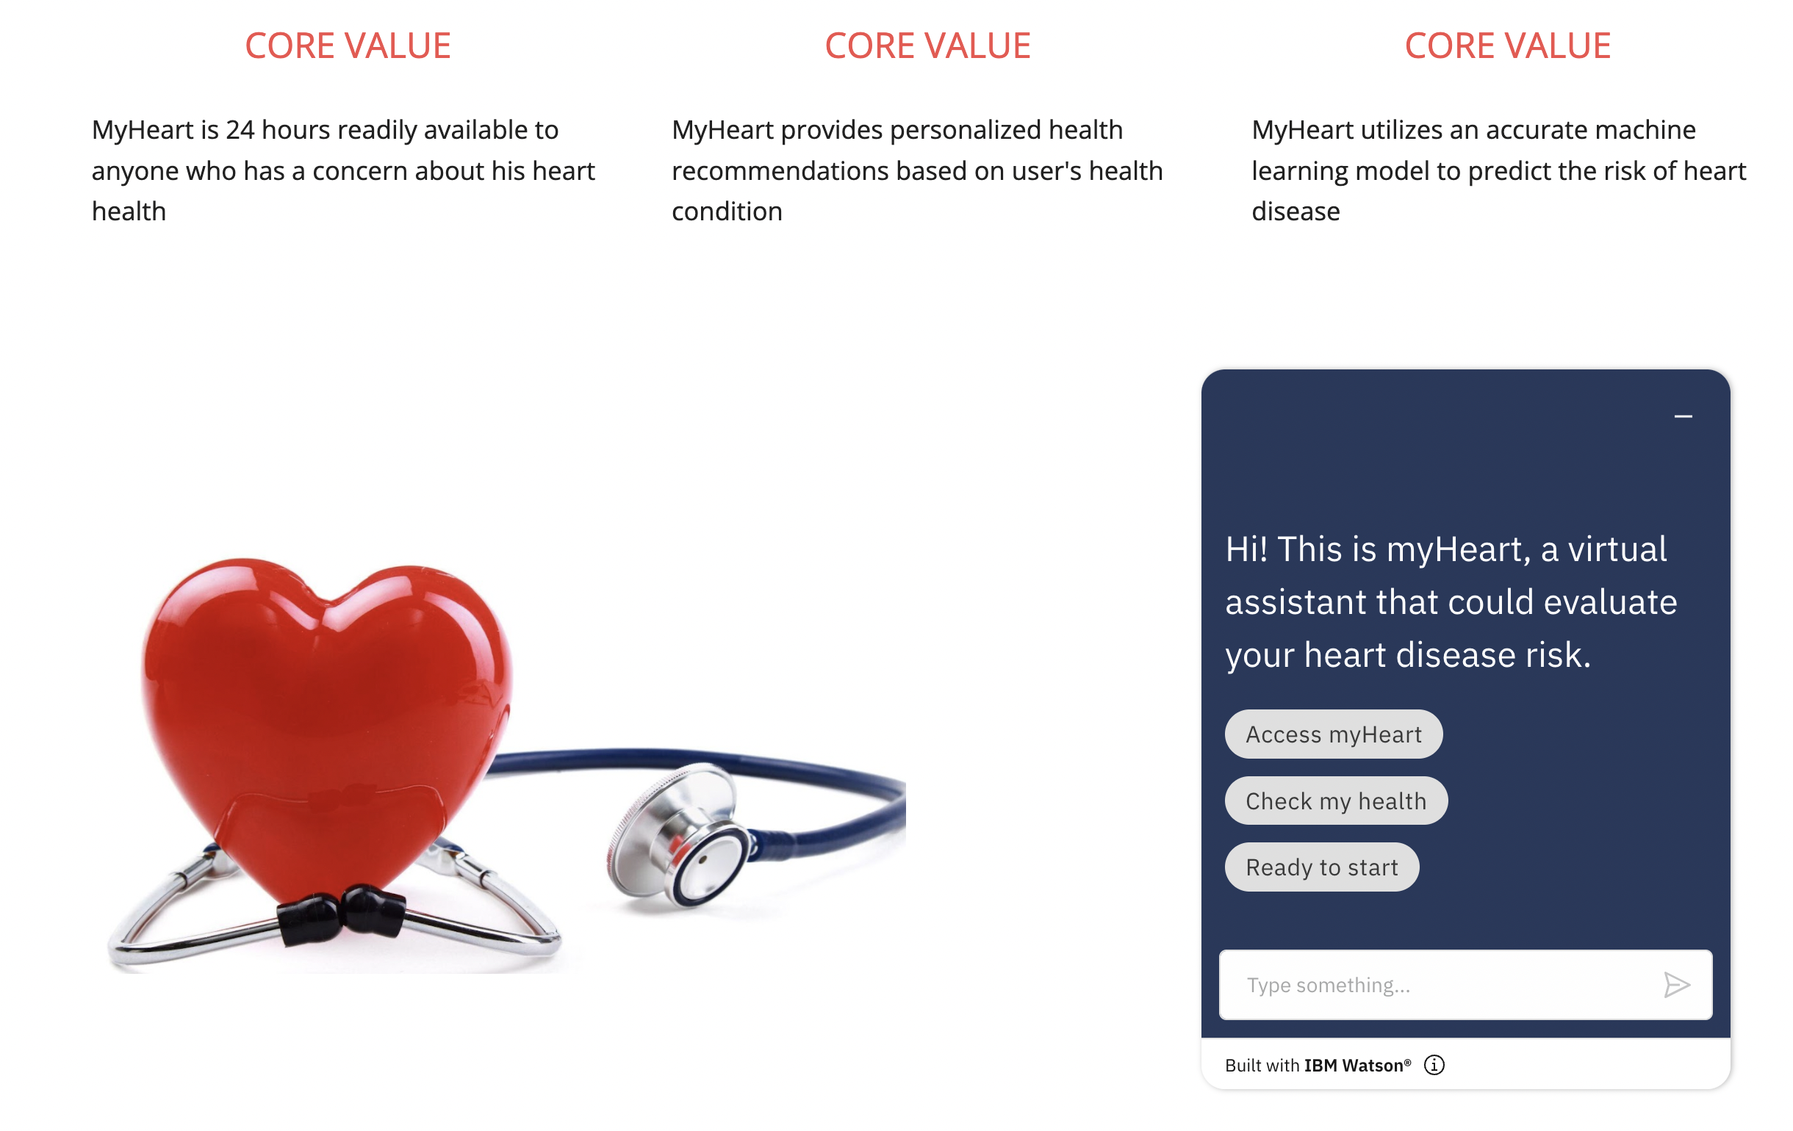
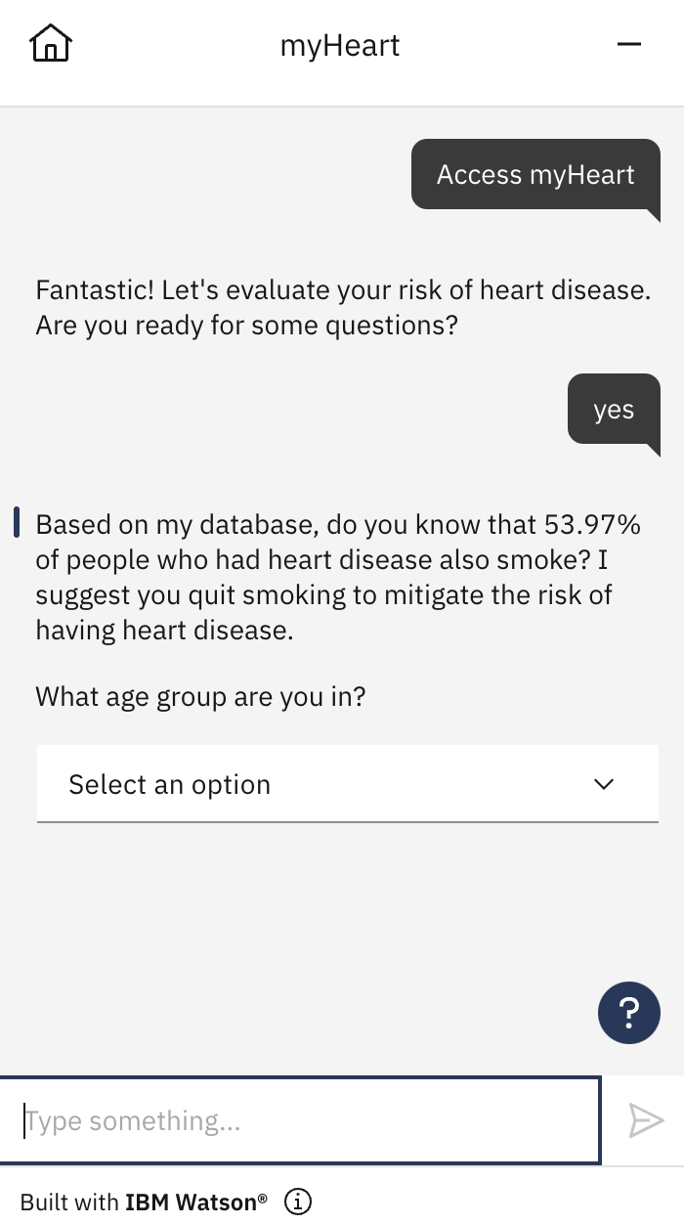
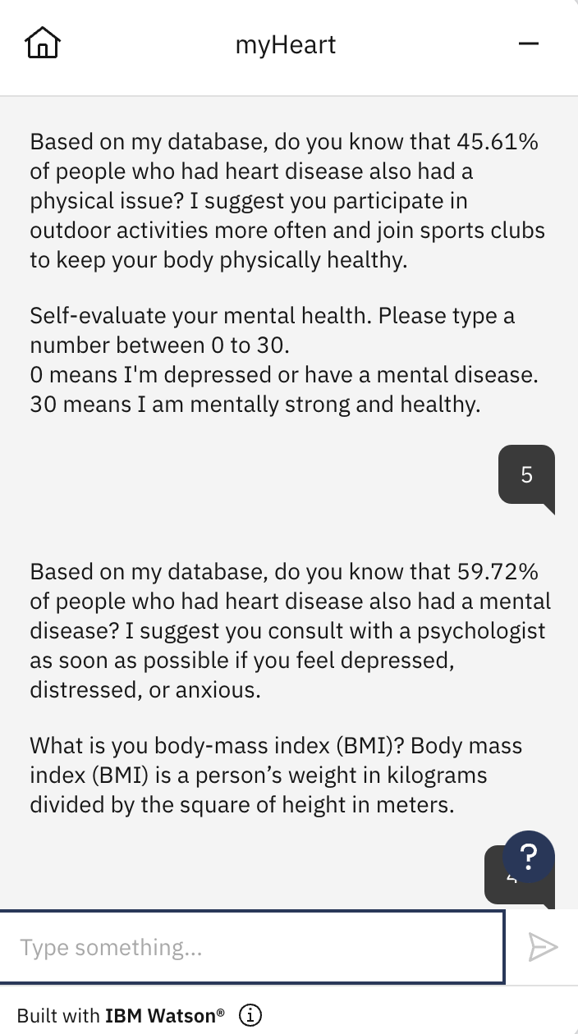
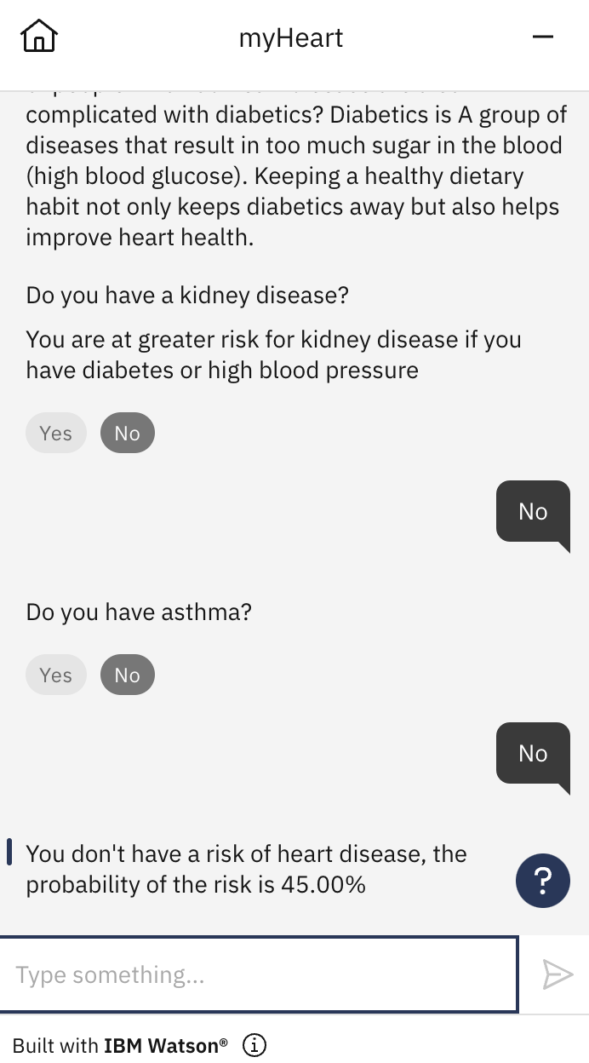
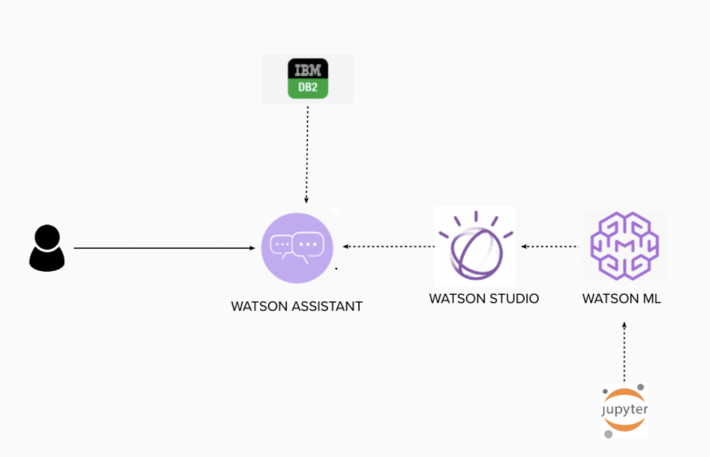
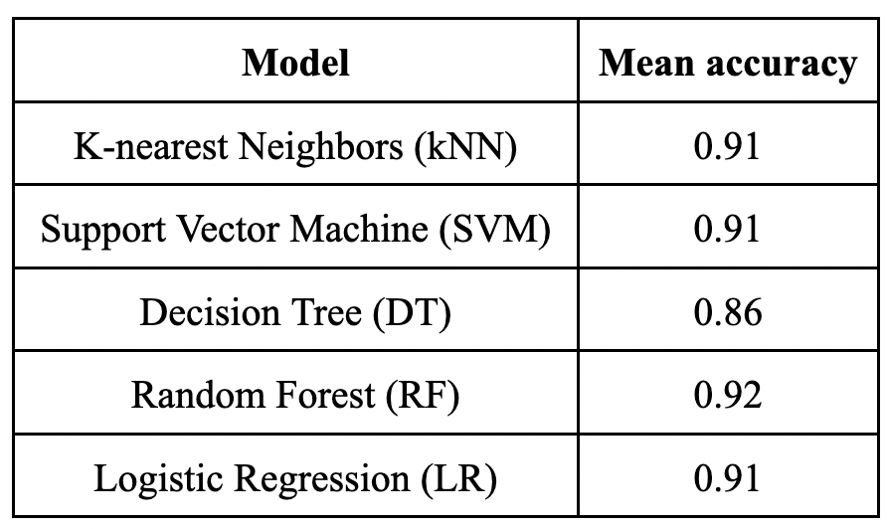
Health Advice on Heart Disease: A Diagnostic Support Tool
Aman Balwan, Eren Alay, Ruixi Wang, Varun Reddy, Xin Zhao
BIA662 - Cognitive Computing
Introduction
According to the CDC, heart disease is one of the leading causes of death both in the United States and globally [1, 2]. Detecting and preventing the factors that have the greatest impact on heart disease is very important in healthcare. Computational developments, in turn, allow the application of machine learning methods to detect "patterns" from the data that can predict a patient's condition. Thus, our diagnostic support tool has the potential to bolster population health management, financial success, and better outcomes across the value-based care continuum primarily targeting individuals at risk of heart disease.
Figure 2. Model evaluation.
Research question
By considering several important clinical parameters that are based on the medical history of the individual, can we create a cognitive system that can accurately and effectively assess the individual’s risk of heart disease?
Data
The dataset relies on 2020 annual CDC survey data of 400k adults related to their health status. We leveraged the updated version of the data found in Kaggle [3]. Our dataset consists of 319795 individuals and 18 variables. Our target variable is the presence/absence of heart disease while features include BMI, smoking, alcohol, stroke, physical health, mental health, sleep time, difficulty in walking, physical activity, gender, age, race, history of diabetes, asthma, skin cancer, and kidney disease.
Methodology
The overall system architecture used in this project is shown in Figure 1. To perform the supervised learning, we utilized several different ML models using TensorFlow. In addition, we also leveraged the power of Auto ML experiments via IBM Watson Studio. We used K-nearest neighbors (kNN), support vector machine (SVM), decision trees (DT), random forest (RF), and logistic regression (LR) as the main modeling strategies for the binary classification task. 90% of the total data is used for training while 10% is taken into consideration for testing purposes. We computed the loss function (binary entropy loss) to access the prediction error. Since the data was imbalanced, we resampled the data using SMOTE approach. Accuracy was chosen as the main model evaluation metric via cross-validation.
Figure 3. Chatbot interaction flow via user interface.
Conclusion
With the advent of technology, conversational agents have been becoming the core of the first resort to be a smooth interface between the technology and the humans. The agents interact with their users in various ways such as a text-based interface (i.e., chatbots) or a speech-based one (i.e., voice assistants) [4]. Via a natural and humanistic user interface, the user tone and intentions can be perceived, analyzed, and addressed [5]. In this direction, we specifically target the healthcare domain and design a cognitive agent that can help the individual assess her/his risk of heart disease. We showed that even a low-cost, simplistic design can pinpoint a person’s risk of heart disease by providing useful recommendations.
Future work
The system we prototyped here can be extended for more tailored use cases. It can not only be used by the medical practitioners to support their decision-making process but also an individual can leverage the power of the cognitive agent. Besides, this system with a bigger database can be deployed over an application that will provide a better user interface and deeper insights into the problems which may lead to heart disease and more personalized solutions to avoid heart diseases.
Figure 1. System architecture.
Results
Out of five modeling strategies, we found that the random forest classifier outperformed the other methods with an accuracy of 0.92. We deployed the best model to Watson Studio and integrate it with the Watson Assistant to enable chatbot activities.
References
[1] Centers for Disease Control and Prevention. Underlying Cause of Death, 1999–2018. CDC WONDER Online Database. Atlanta, GA: Centers for Disease Control and Prevention; 2018. Accessed March 12, 2020.
[2] Cardiovascular diseases (CVDs) fact sheet. WHO. Retrived from: https://www.who.int/news-room/fact-sheets/detail/cardiovascular-diseases-(cvds)
[3] Heart disease prediction dataset. Personal key indicators of heart disease. Kaggle. Retrieved from: https://www.kaggle.com/code/andls555/heart-disease-prediction/data
[4] Dingler, T., Kwasnicka, D., Wei, J., Gong, E., & Oldenburg, B. (2021). The Use and Promise of Conversational Agents in Digital Health. Yearbook of medical informatics, 30(1), 191–199. https://doi.org/10.1055/s-0041-1726510
[5] Michael Braun, Anja Mainz, Ronee Chadowitz, Bastian Pfleging, and Florian Alt. 2019. At Your Service: Designing Voice Assistant Personalities to Improve Automotive User Interfaces. In Proceedings of the 2019 CHI Conference on Human Factors in Computing Systems (CHI '19). Association for Computing Machinery, New York, NY, USA, Paper 40, 1–11. https://doi.org/10.1145/3290605.3300270
Table 1. Model comparison.

